Slide 1
Day 05
MySQL
JOINS

Slide 2
What are JOINs and How they are Useful
In MySQL, JOIN operation allows us to combine data from two or more tables based on a related column, or set of column.
JOINs are useful for querying data from multiple tables as if they were a single table, allowing us to access related data from different tables in a single query.
JOINs are useful in many scenarios, such as, when we need to retrieve data that is spread across multiple tables, or when we need to aggregate data from multiple tables.
JOINs can also be used to combine data from multiple tables into a single table for reporting or analysis purposes.
JOINs are an essential tool for data analysis in MySQL, as they allow you to combine data from multiple tables & retrieve only the records that meet specific criteria.
Depending on our data analysis needs, we may use one or more types of JOINs to extract valuable insights from our data.

Slide 3
Types of JOINs
INNER JOIN: Returns only the rows from both tables that have matching values in the specific columns. Used to retrieve records that have matching values in both tables.
LEFT JOIN: Returns all the rows from the left table & matching rows from the right table. If there is no match in the right table, the result will still include all the rows from the left table with NULL values in the right table. Useful when we want to retrieve all records from the left table, regardless if whether there is a match in the right table or not.
RIGHT JOIN: Similar to LEFT JOIN, returns all the rows from the right table and matching rows from the left table. If there is no match in the left table, the result will still include all the rows from the right table, with NULL values for the columns in the left table. Useful when we want to retrieve all records from the right table, regardless of whether there is a match in the left table or not.
CROSS JOIN: Combines each row from one table with every row from another table to create a ‘Cartesian Product’. Useful in generating all possible combinations of rows, or comparing data across tables, or finding missing data.
NATURAL JOIN: Combines two tables based on their common column names. It returns all rows from both tables where the column names match, without explicitly specifying the columns to join on.
This is not a comprehensive list of all types of JOINS. There are some more, but these are most important ones in Data Analysis.

Slide 4
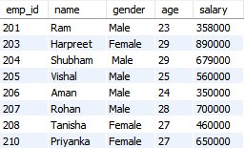
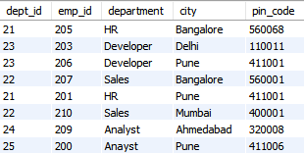
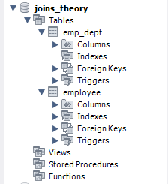
Database & Tables used in this presentation
We are using a database called ‘ joins_theory’ that has two tables
employee
emp_dept
This table contains columns emp_id, name, gender, age & salary. This table has 8 records.
This table contains columns dept_id, emp_id, department, city & pin_code. This table also has 8 records.
database
employee
emp_dept

Slide 5
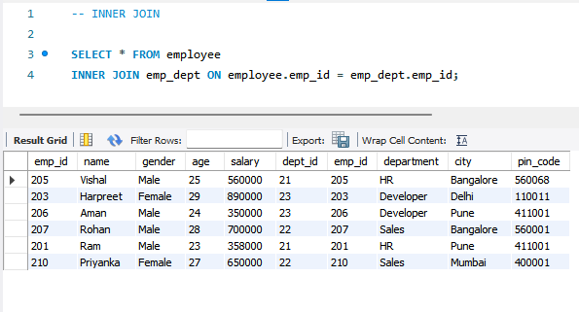
INNER JOIN
Here, we are performing INNER JOIN on both the tables.
Syntax:
SELECT column1,column2 …
FROM table1
INNER JOIN table2
ON table1.column = table2.column
We have performed INNER JOIN on the emp_id column which is common in both the tables.
The resulting table has all the columns from both the tables where there is a match.
This is useful in combining data from multiple tables and analyzing relationships between them.

Slide 6
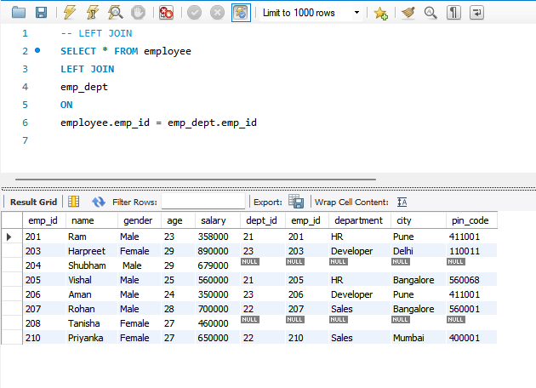
LEFT JOIN
Syntax:
SELECT column1,column2 …
FROM table1
LEFT JOIN table2
ON table1.column = table2.column
The resulting table has all the rows from employee table (left table) and the matching rows of emp_dept table (right table).
The NULL values in table ‘emp_dept’ means there are some employees in ‘employee’ table that belong to no department.
This gives all the records in the left table, no matter if there is a match in the right table or not.
The matched rows help us to give complete information about the data.

Slide 7
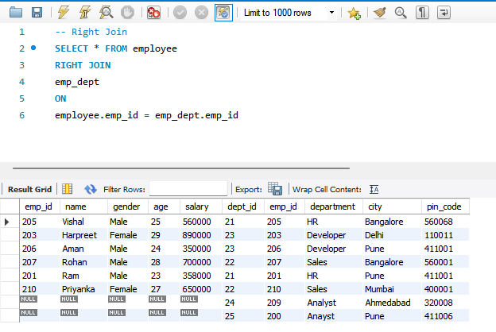
RIGHT JOIN
Syntax:
SELECT column1,column2 …
FROM table1
RIGHT JOIN table2
ON table1.column = table2.column
The resulting table has all the rows from ‘emp_dept’ table (right table) and the matching rows of ‘employee’ table (left table).
The NULL values in table ‘employee’ means there are some values in ‘emp_dept’ table that does not matches with values in left table.
This gives all the records in the right table, no matter if there is a match in the left table or not.
The matched rows help us to give complete information about the data.

Slide 8
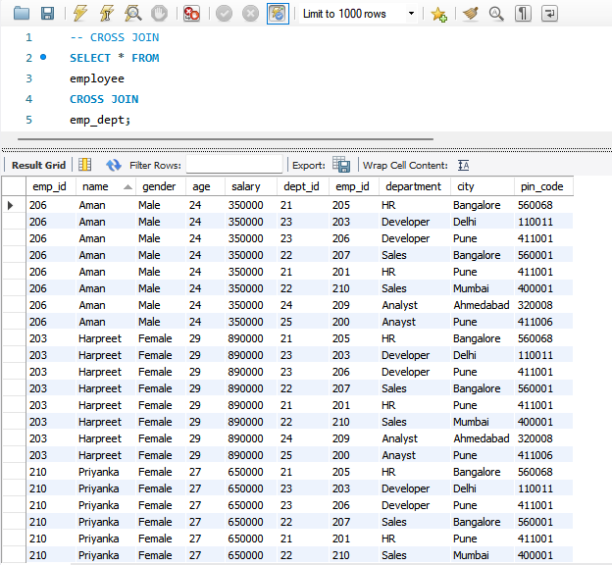
CROSS JOIN
Syntax:
SELECT *
FROM table1
CROSS JOIN table2
The resulting table has number of rows equal to the product of the number of rows in both tables.
CROSS JOIN can be very resource intensive, and should be used with caution, especially when working with large dataset.

Slide 9
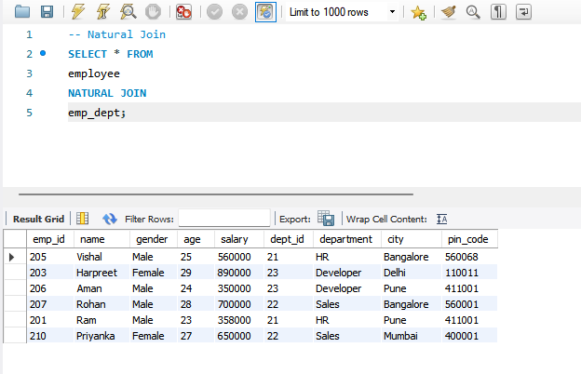
NATURAL JOIN
Syntax:
SELECT *
FROM table1
NATURAL JOIN table2
The resulting table joins both the tables based on the common column ‘emp_id’ without explicitly specifying.
NATURAL JOIN can be prone to unexpected results if the column names are not unique or if the column data types are not compatible. We must take care of it.

Slide 10
CONCLUSION
A Join is a way to combine data from two or more tables in MySQL based on related columns between them.
There are several types of JOINS like INNER,LEFT, RIGHT, CROSS, NATURAL and so on.
Basic Syntax
SELECT
column1, column2, ...
FROM
table1
INNER/LEFT/RIGHT/CROSS/NATURAL JOIN
table2
ON
table1.column = table2.column;
GitHub Repository
https://github.com/rahulpal-1991/Refresh-MySQL-Skills-in-7-Days

